Slide 1





BY REALLYGREATSITE
CLIENT:WARNER & SPENCER
YOUR
LOGO
SEO
Report
AUGUST
2023

Slide 2

BY REALLYGREATSITE
AUGUST 2023
01.
Backlink Profile
02.
Customer Acquisition
03.
Top Keywords
04.
Our Goals
05.
Our Strategy
06.
Summary

Slide 3




BY REALLYGREATSITE
AUGUST 2023
Current Backlink Profile
1566
2544
4110
DA 60+
Backlinks
Up to DA 40
Backlinks
Total
Backlinks

Slide 4
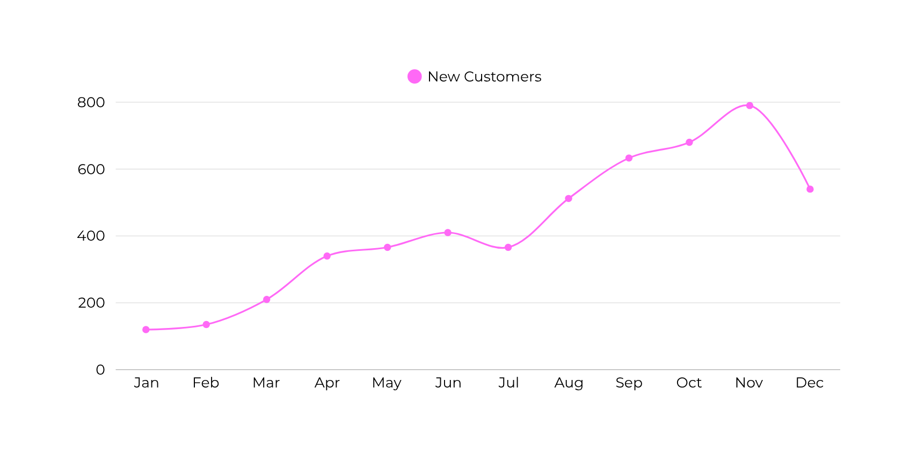
BY REALLYGREATSITE
AUGUST 2023
Customer Acquisition
2022 Statistics

Slide 5
BY REALLYGREATSITE
AUGUST 2023
Current Top Keywords
Keyword
Rank
Traffic
CPC
Creative Studio
33
4500+
$2.1
Branding Studio
15
2500+
$1.5
Logo Design
2
44200+
$8.1
Webdesign in NY
6
34600+
$6.1
Branding System
58
1300+
$1.2
Website Design
3
50500+
$9.4

Slide 6
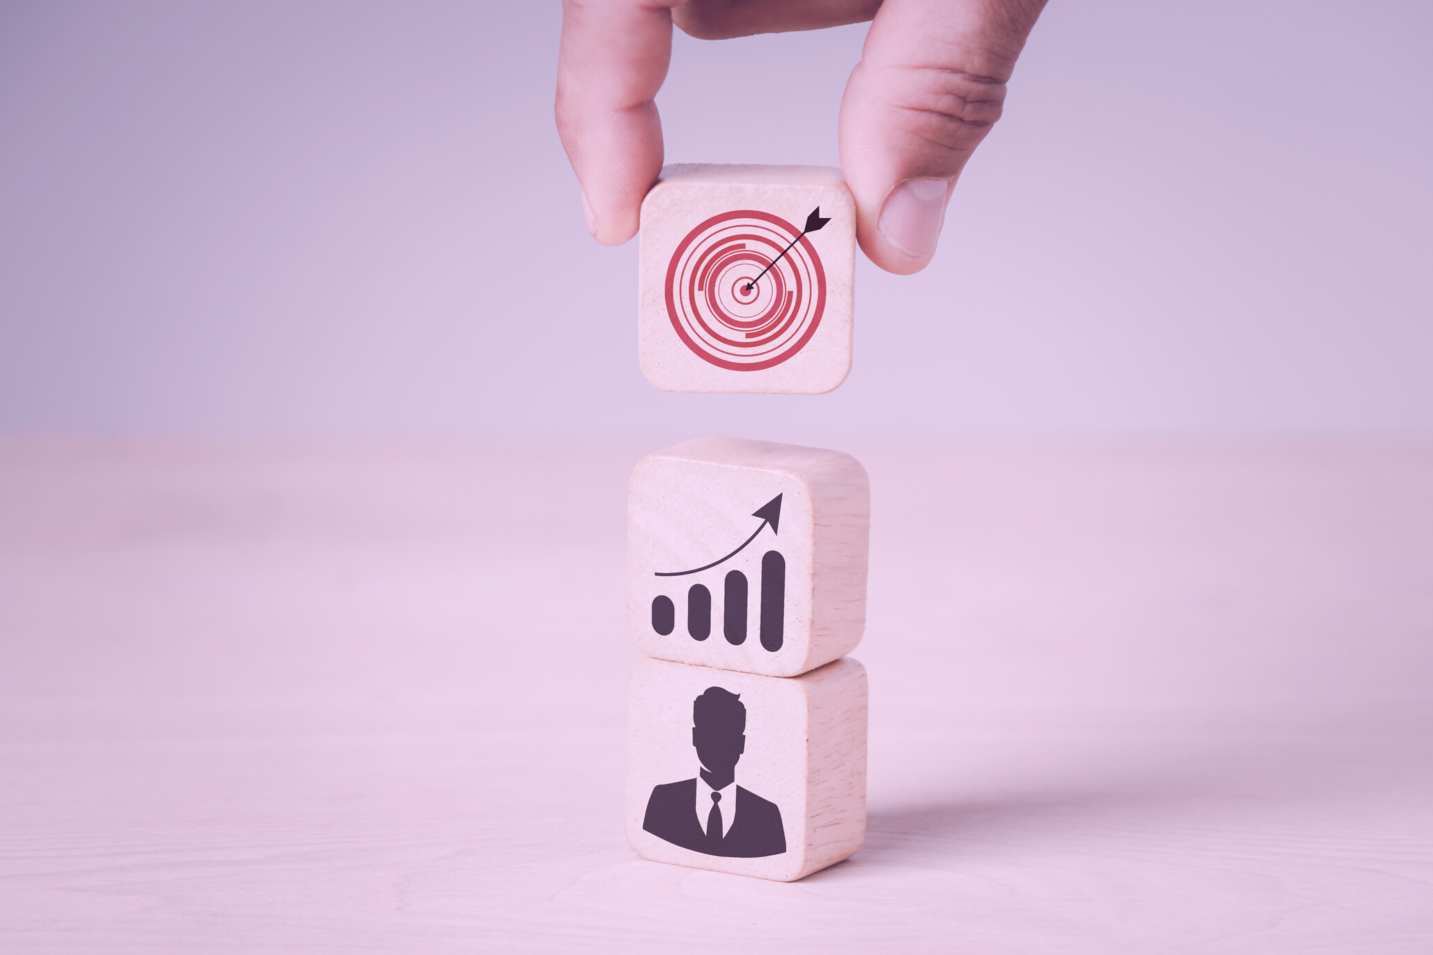
BY REALLYGREATSITE
AUGUST 2023
Our Goals
For Q4 2023

Slide 7

BY REALLYGREATSITE
AUGUST 2023
Our Goals
Our Top Priorities for The Next Few Months
01.
Building
More Backlinks
02.
Creating
New Content
Getting to 1000 Backlinks
Creating More Valuable and Shareable Content
03.
Increasing
Organic Reach
04.
Improving Conversion
Ranking Higher Through Strategic SE Optimization
Converting More Visitors
to Subscribers

Slide 8

BY REALLYGREATSITE
AUGUST 2023
How we Build More Backlinks
01.
Finding Broken Links
04.
Create Skyscraper Content
02.
Building Linkable Content
05.
Create Infographics
03.
Partner For Do Follow Links
06.
Create Awareness on Social Media

Slide 9
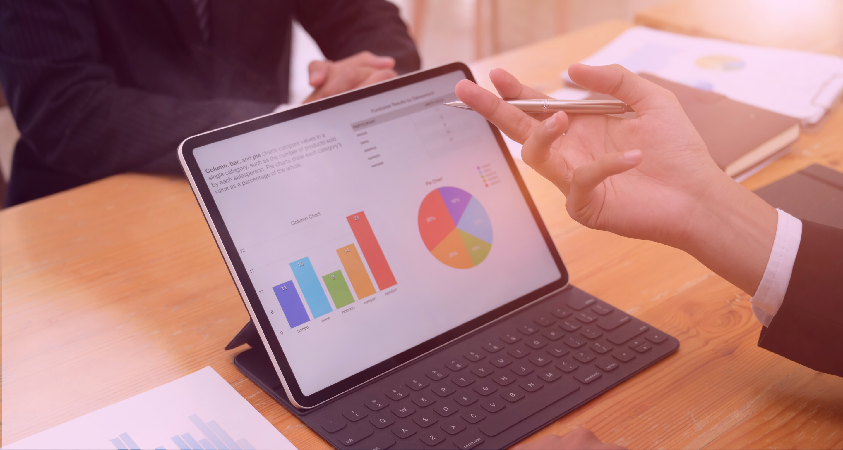
BY REALLYGREATSITE
AUGUST 2023
Our Pillars of Content
What types of content are we creating?

Slide 10



BY REALLYGREATSITE
AUGUST 2023
Our Pillars of Content
01
02
03
Skyscraper Content for Creators
Short Form Tutorials for Youtube
DIY Educational Series Articles for Creators

Slide 11
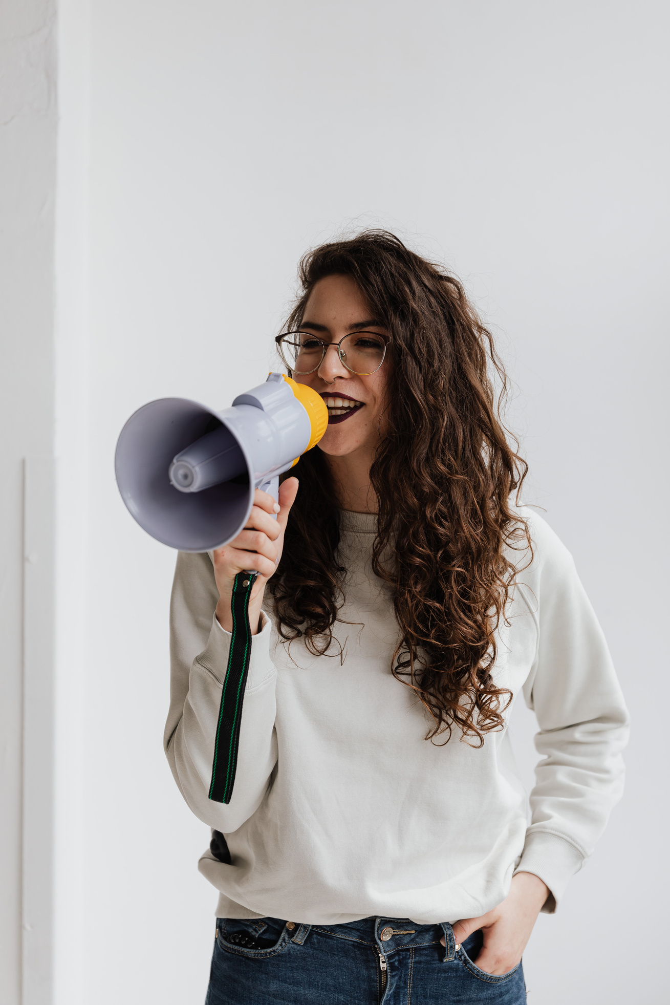
BY REALLYGREATSITE
AUGUST 2023
Increasing Reach
To increase there is pretty much only a few top level strategies that we can employ and they all involve creating new valuable content and finding ways to deliver it to our potential target audience

Slide 12
BY REALLYGREATSITE
AUGUST 2023
How to Improve Conversion
01.
02.
03.
Use Clear Call
to Actions
Use More Call to Actions
Use Subtle Pop Up Prompts
04.
05.
06.
Use Only Relevant CTA on Any Page
Make the Sign Up Process Painless
Improve Page Load Speeds

Slide 13
BY REALLYGREATSITE
AUGUST 2023
Our
Strategy

Slide 14
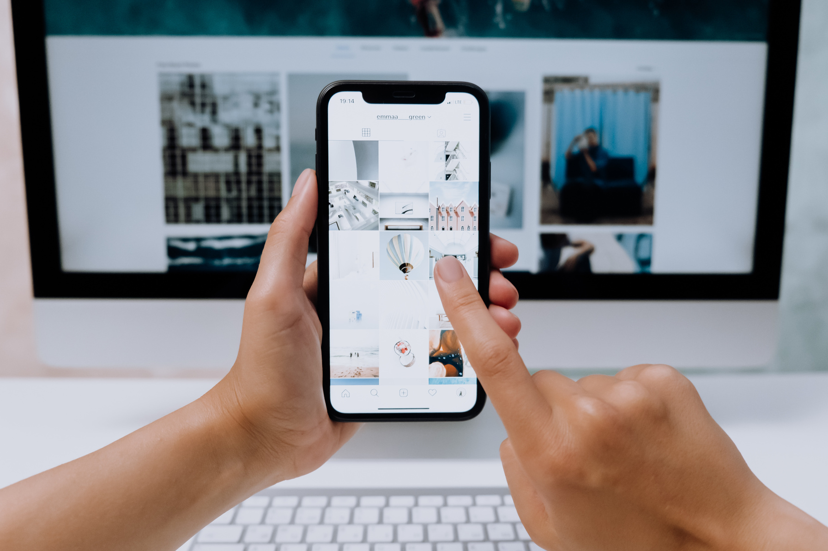
BY REALLYGREATSITE
AUGUST 2023
Our Top Priority
Increasing Organic Traffic
The main criteria our strategy should be evaluated by is the organic traffic the website is getting from quarter to quarter. If the number are going up, we're doing what we're paid to do.

Slide 15
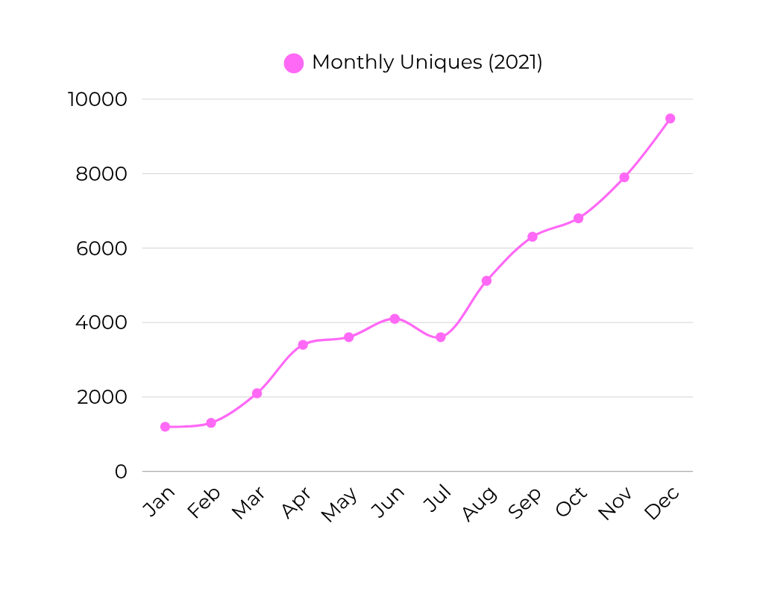
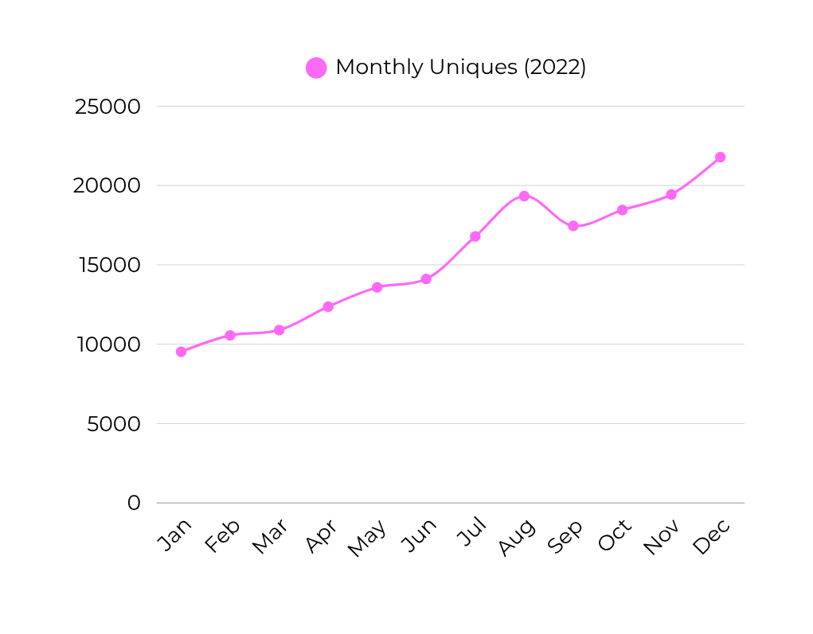
BY REALLYGREATSITE
AUGUST 2023
Traffic
Year Over Year

Slide 16
BY REALLYGREATSITE
AUGUST 2023
Pillars of Content Strategy
On Page Optimization
Link Building Outreach
Keep executing the pillars of content strategy to create more linkble content for the audience.
To make the pages easier to find for potential audience through search engines, use the correct keywords, tags and headings.
The most effective and the fastest way to build backlinks next to creating super valuable content is still direct outreach.

Slide 17
BY REALLYGREATSITE
AUGUST 2023
Keywords to Target
Keyword
KW Rank
Traffic
CPC
Creative Studio
33
4500+
$2.1
Branding Studio
15
2500+
$1.5
Logo Design
2
44200+
$8.1
Webdesign in NY
6
34600+
$6.1
Branding System
58
1300+
$1.2
Website Design
3
50500+
$9.4

Slide 18

BY REALLYGREATSITE
AUGUST 2023
Summary

Slide 19
BY REALLYGREATSITE
AUGUST 2023
Summary
What Has Happened
01
Traffic Keeps Increasing
02
More Backlinks Year Over Year
03
More Valuable Content Added
What We'll Work On
01
Focus on New Keywords
02
Keep Adding Linkable Content
03
Focus on the Three Pillar Strategy

Slide 20


BY REALLYGREATSITE
AUGUST 2023
That's It!
Have Any Questions?
Let's Keep in Touch
@reallygreatsite
reallygreatsite.com
@reallygreatsite
hello@reallygreatsite.com
@reallygreatsite
123-456-7890

